Slide 1
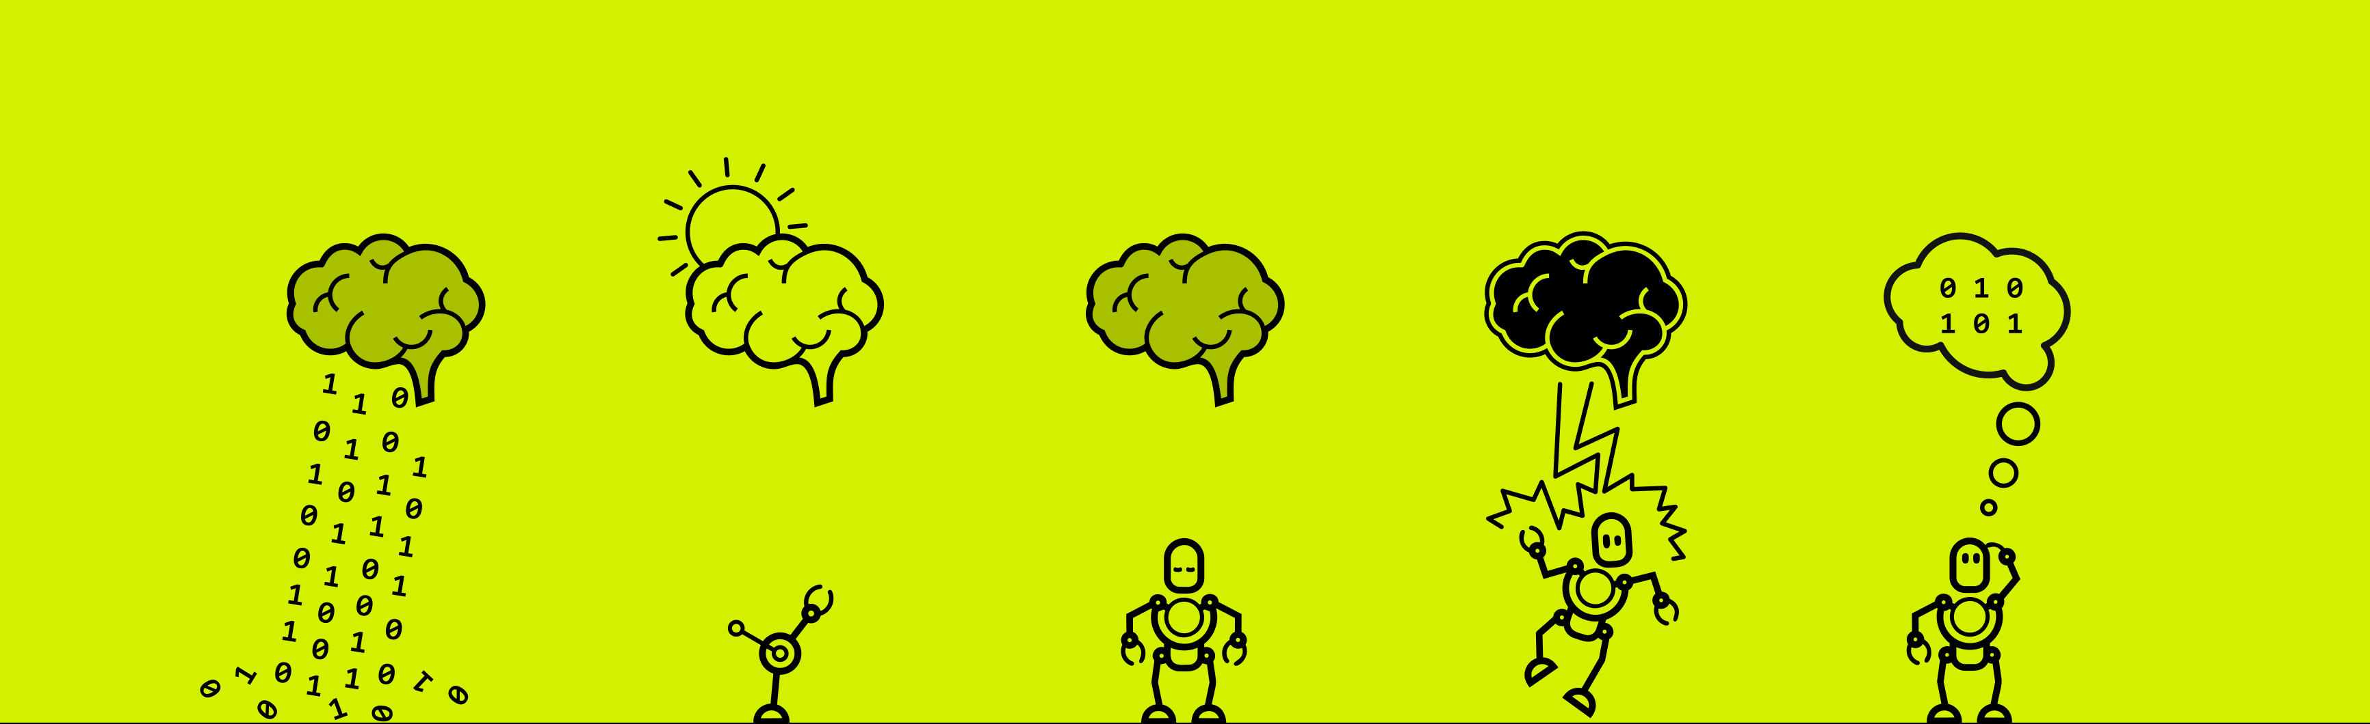


Slide 2

Data Analysis -Stroke Rehab Data Analysis
Christos, Deepa, Mihaela and Marjaneh
Team Name : MOVE
Team : 15

Slide 3
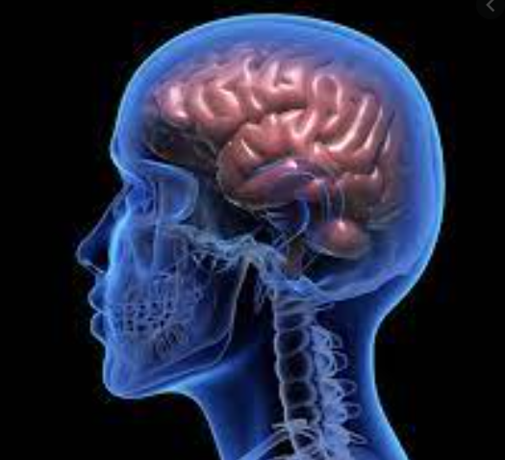
Introduction
Stroke are severe motor and sensory impairment.
Rehabilitation process
Different for each patient
Physical therapy is needed to overcome to stroke effects.
need for improved approaches to support motor rehabilitation therapy
Brain Computer Interfaces (BCI) can be use to improve it.

Slide 4
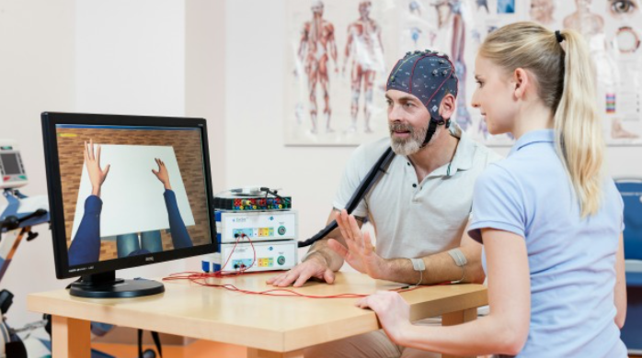
Data
3 Patients
Pre_train
Post_train
Pre_test
Pre_test
Pre : first rehabilitation session
Post : last rehabilitation session
Mat Files :
Frequency : 256 hz
Trigger : 0, +1, -1
y : 16 channels eeg signals

Slide 5
Tools
Python
Libraries :
Sklearn,
matplotlib,
ICA
neurokit2
Mne
Matlab
EEGLab
Digital Signal Processing Toolbox

Slide 6
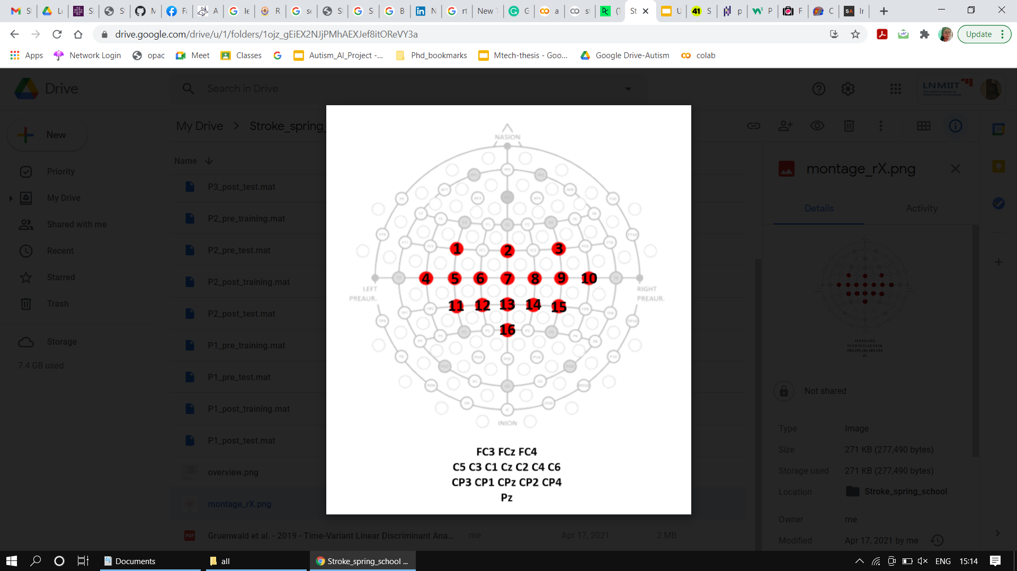
Pearson Correlation of Movements on Activated brain area:
Activated electrodes: considered top 8 (descending order)
For Pre train (4, 2, 13, 11, 6, 14, 9)
For Pre test ( 4, 11, 10, 15, 2, 14, 12)
For Post Train (1, 6, 12, 11, 5, 3, 7)
For Post Test (1, 6, 5, 12, 0, 3, 4)
1: FC3, 2: FCz , 3: FC4
4: C5, 5:C3 , 6:C1 , 7:Cz , 8:C2 , 9 :C4 , 10:C6 ,
11:CP3 , 12: CP1 , 13: CPz , 14: CP2

Slide 7
Observations
For Pre , C5 , CP3 , CP2 , FCz ( common areas activated for test and train)
For Post, FC3 , C3, C1, FC4 , CP1 ( common activated areas for test ,train)

Slide 8
Raw Data : LDA with CSP mean
Subject ID | score Train | Score Test
P1_pre | 0.55625 | 0.5125
P1_post | 0.8375 | 0.15
P2_pre | 0.4875 | 0.4375
P2_post | 0.53125 | 0.675
P3_pre | 0.51875 | 0.4625
P3_post | 0.53125 | 0.475

Slide 9
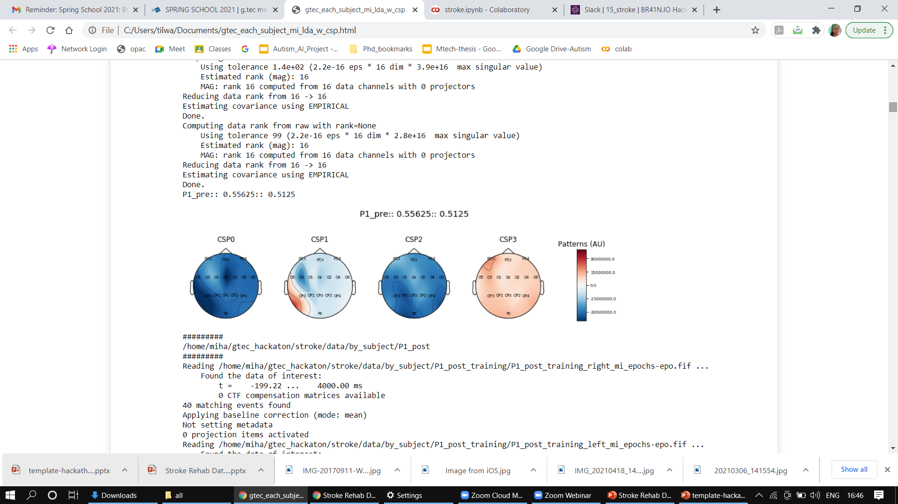
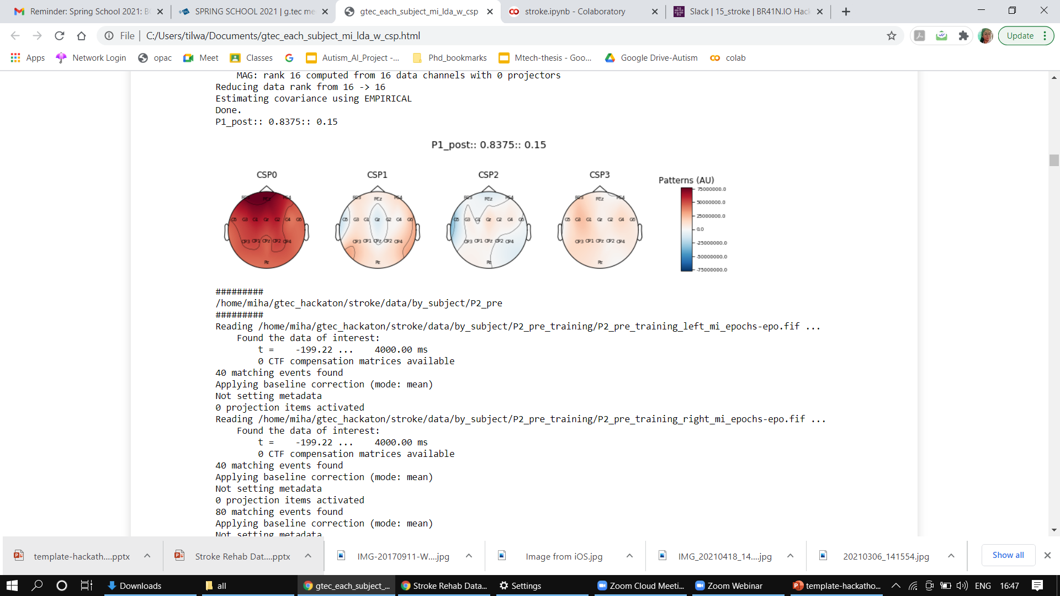
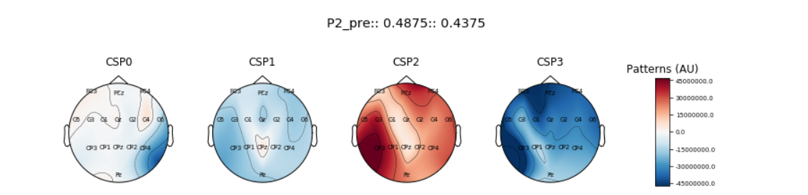
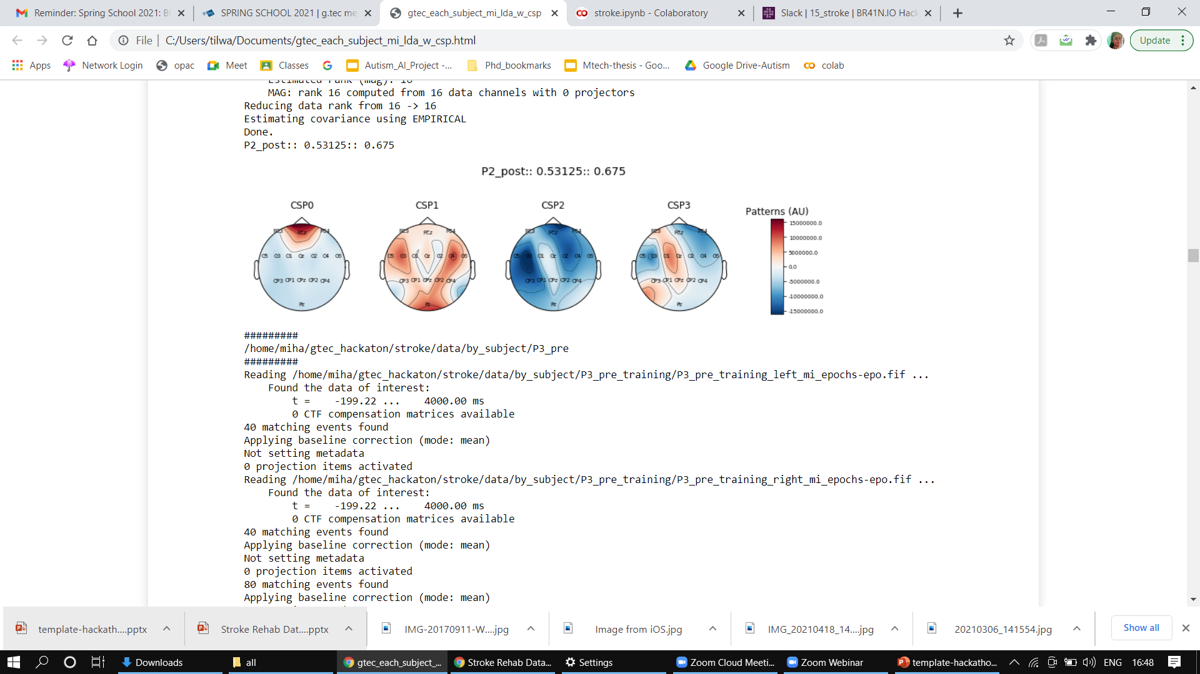
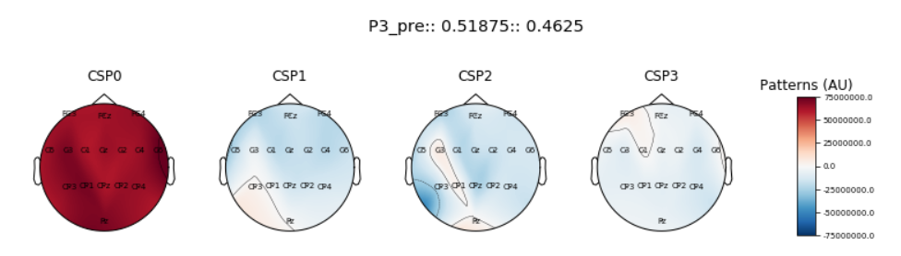
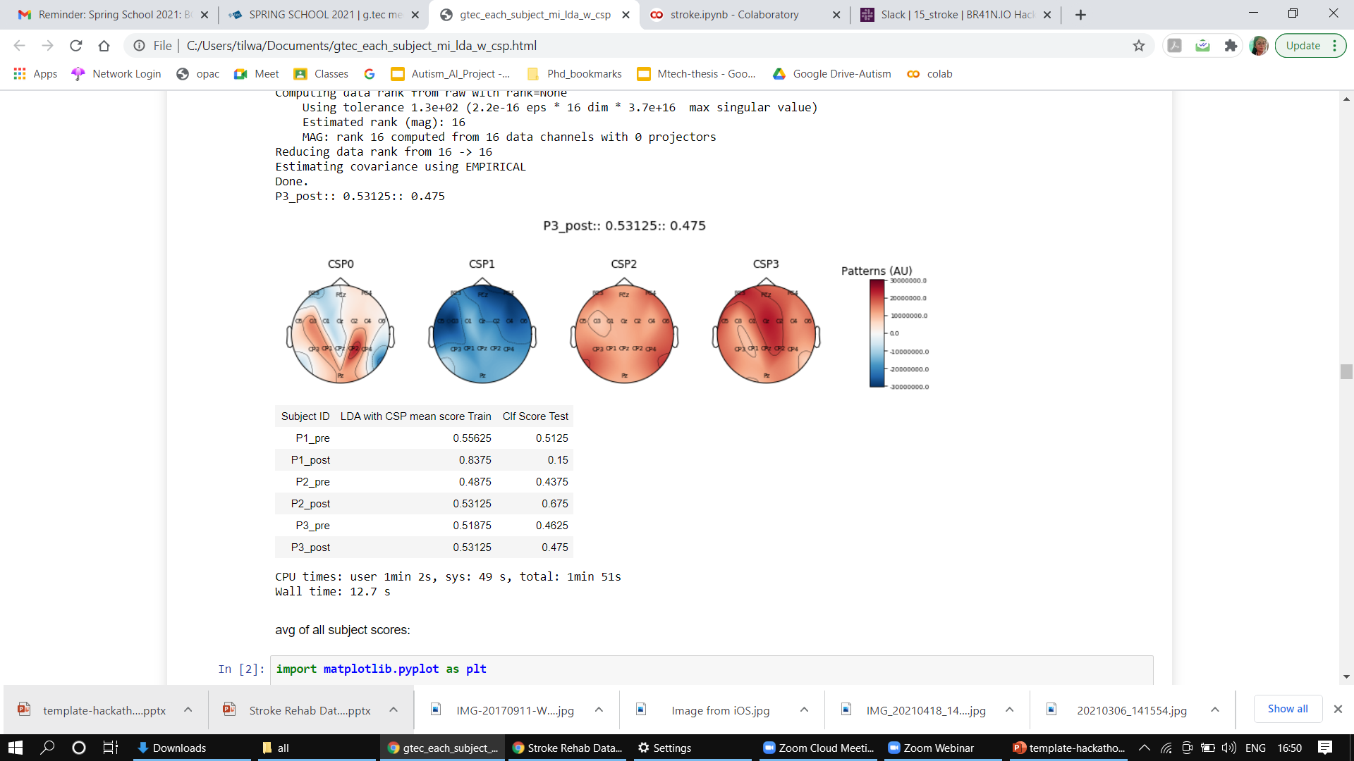
Observations LDA+CSP mean

Slide 10
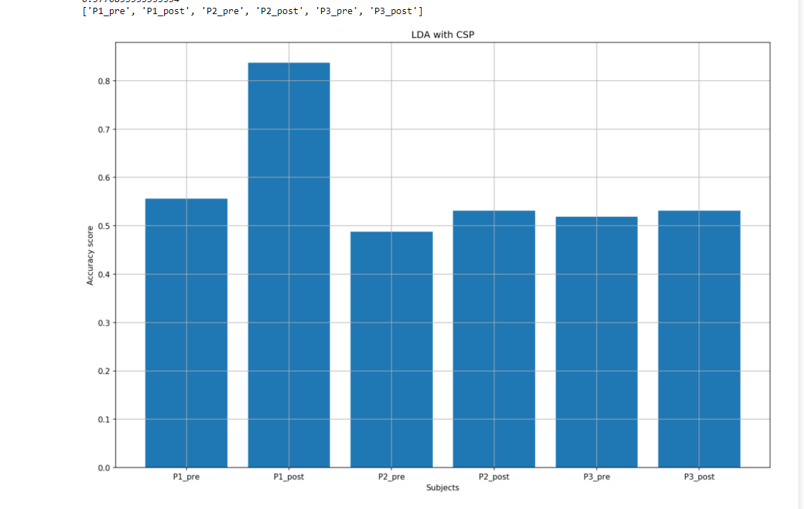
Results : LDA+CSP

Slide 11
Denoising with Wavelength
First step: Denoising EEG Signal using wavelet Decomposition and use a bandpass filter to avoid artifacts
No artifacts found as such
Second step: Feature extraction using Arima model and entropy feature
Third step: Reduce features using Anova Test
Fourth Step : LDA +CSP

Slide 12
After Denoising Results after Denoising LDA+CSP
Subject ID | score Train | Score Test
P1_pre | 0.49375 | 0.55
P1_post | 0.83125 | 0.1625
P2_pre | 0.575 | 0.5125
P2_post | 0.58125 | 0.6875
P3_pre | 0.475 | 0.45
P3_post | 0.5375 | 0.525

Slide 13
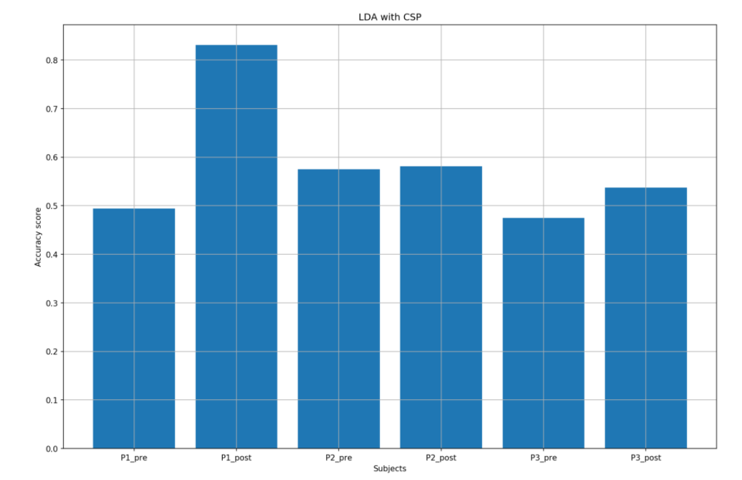
Results after wavelength denoising: LDA+CSP

Slide 14
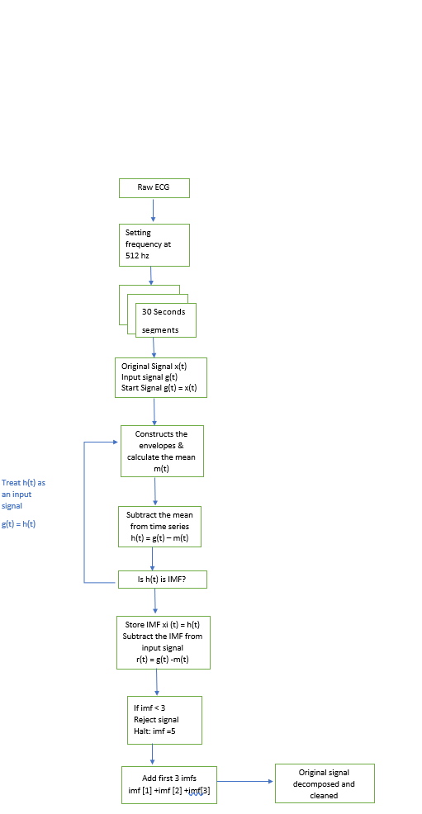
EMD for Signal Artifact Removal

Slide 15
Methodology
Extracted -1, +1
I.e left and right moments
EMD Decomposed
Signals
Combined P1,P2,P3
-1
+1 : Left
-1 : Right
Classifier
With 10 cross validation.
Data preprocessing
Feature Extraction
+1

Slide 16
Classifiers Used
Multilayer Perceptron Classifier
Hybrid Model (Bidirectional Long Short Term +
Convolution Neural Network)
Random Forest -- (Machine Learning)
10 Cross Validation Used for all Algorithms
Deep Learning
Algorithms

Slide 17
Results
Algorithms |  | Accuracy | Specificity | Sensitivity
EMD+MLP Classifier | Pre Post | 85.7% 92.3% | 0.86 0.87 | 0.83 0.85
BLSTM + CNN | Pre Post | 71% 78% | 0.72 0.73 | 0.67 0.75
Random Forest | Pre Post | 77.3% 89.2% | 0.73 0.87 | 0.76 0.88

Slide 18
Ending Note
Best Model : Multilayer Perceptron
We want to train more classifiers but due to time limit we have these results only.
Created BCI pipelines for data analysis.
Algorithms Compared in whole study:
LDA+CSP
Wavelength denoising LDA+CSP
EMD Denoising :
Multilayer Perceptron Classifier
Hybrid Model (BLSTM +CNN)
Random Forest.

Slide 19



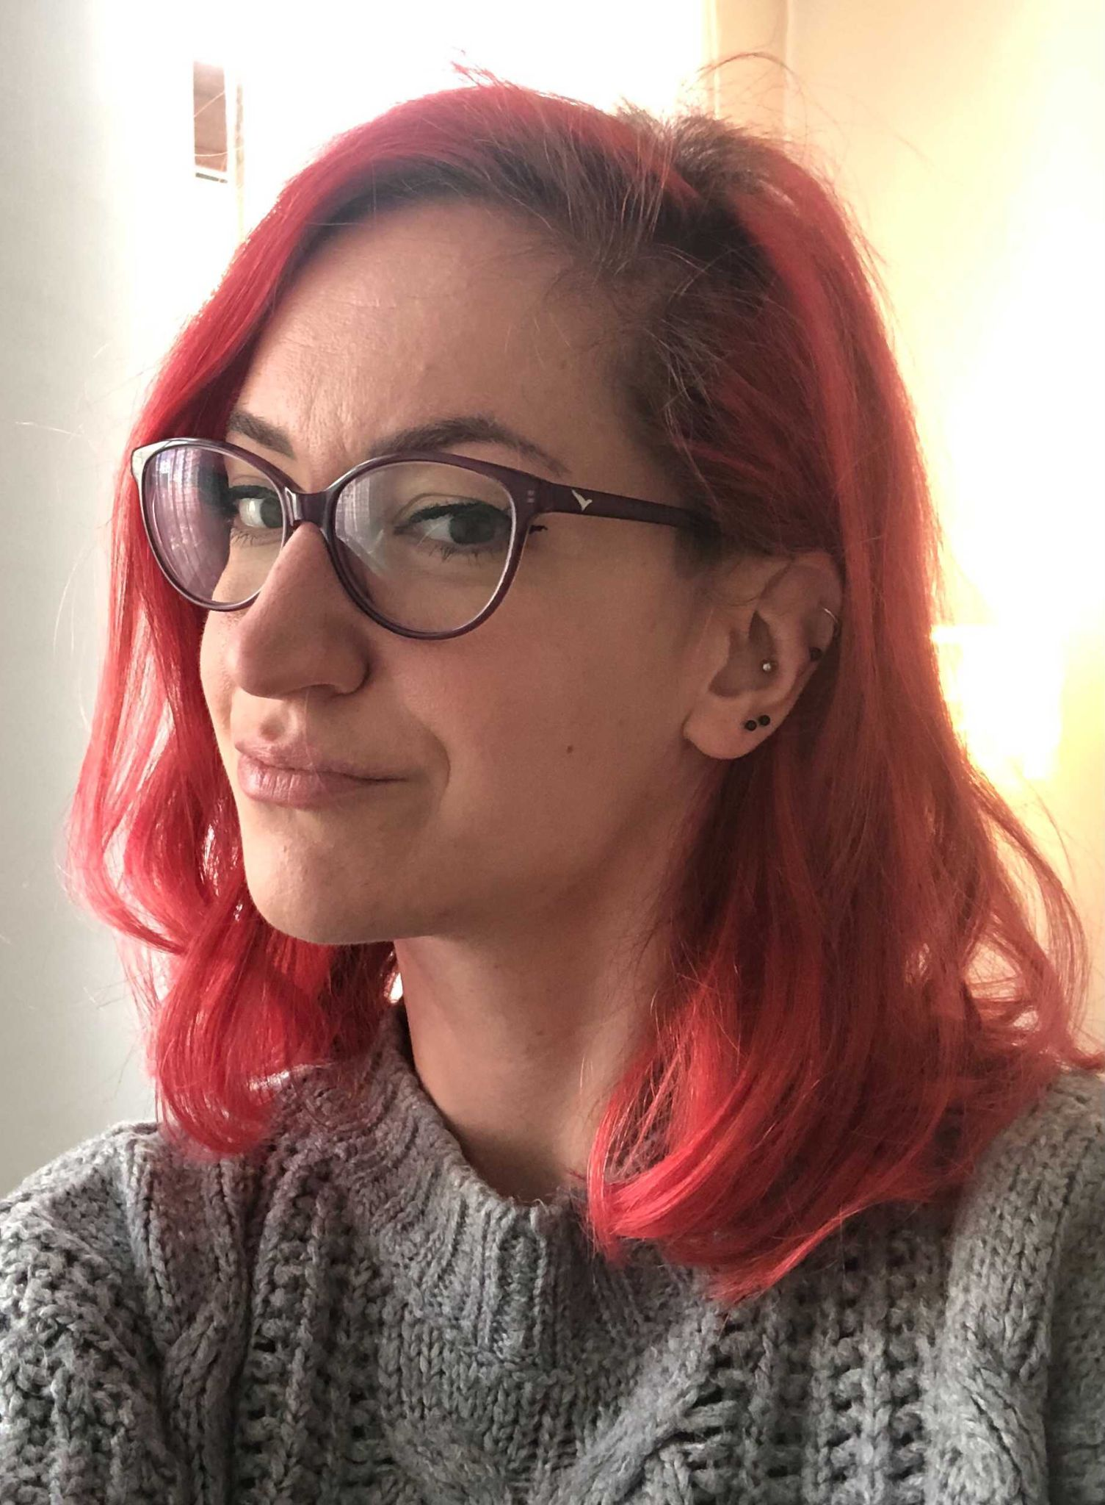
TEAM - MOVE
Deepa Tilwani : tilwanideepa2@gmail.com
Christos Stergiadis :christosstergiades@gmail.com
Mihaela Maracine : mihaela.maracine1@gmail.com
marjaneh habibian : marjaneh.habibian@gmail.com

Slide 20
About Me:
Deepa Tilwani
Research Scholar : The LNM Institute of Information Technology, Jaipur, India.
Research Intern : AI Institute, University of South Carolina, USA
Working on Autism Detection using ECG.
Email : tilwanideepa2@gmail.com

Slide 21
THANK YOU!
QUESTIONS???

